Slide 1

Comfort Centre Training
Level 1

Slide 2

Welcome and Thanks for being here!
Notes:
Instructor: Take this time to introduce yourself.
A little about you and your background
Your involvement with EMO/JEM
Lesson Plan
Learning Outcomes

Slide 3
Purpose
To demonstrate a general understanding of what a Comfort Centre is, general requirements and process to getting one setup and operational.

Slide 4

Introduction to the HRM EM program
In 1990, the NS Legislature passed the Emergency Management Act
  This means that each municipality in NS must have:
HRM Emergency Management Act Report Card | HRM Emergency Management Act Report Card
An Emergency Management By-Law |  | BY-LAW NUMBER E-100 – Respecting of a prompt and coordinated response to an emergency
An Emergency Management Organization
An Emergency Management Director |  | Erica Fleck – HEM Emergency Management Director
An executive planning committee |  | EMO Planning Committee
Prepared and approved emergency plans |  | HRM Municipal Emergency Plan
Notes:
How does HRM meet these requirements?

Slide 5

Halifax Municipal Emergency Plan
This is where the JEM Teams gain the authority to carry out their functions, such as:
  community relationship building
  emergency preparedness exercises
  reviewing and updating of evacuation profiles
  provide public education sessions for residents
  coordinating humanitarian efforts
This is where Comfort Centers fall

Slide 6
Telecommunications options
99% of the time communication will follow normal methods:
When conditions require it, Comfort Centres can use:
Existing facility telephones
Cell phones
Email
Two-way radios
Amateur Radio
Notes:
Telecommunications are part of the EM/JEM structure
Each JEM team in HRM has a facility to set up telecommunications
Called a Joint Support Centre (JSC)
Telecommunication services may be provided to a Comfort Centre upon request
EM has access to several types of radios
TMR
VHF
Amateur Radio (UHF, VHF, HF, Winlink, etc
The VHF radios are completely independent of all other systems and are mobile, complete with a mobile repeater on a trailer
the trailer usually goes to all the JEM Jamborees

Slide 7
Joint Emergency Management Teams (JEM)
Notes:
JEMs were first called Local Disaster Planning Committees
Started in 2000 in the Sheet Harbour area
As a result of the Swissair crash of 1998
Name was changed to Joint Emergency Management by the volunteers in 2005
JEM is totally unique to HRM
Developed by EM volunteers
By the community and for the community
Neighbours helping Neighbours
12 Teams (in order of when formed)
Sheet Harbour and Area
Eastern Shore
Western Region
Musquodoboit Valley
RiverLakes
Dartmouth
Mulgrave
Peninsula South
Mainland North
Chebucto
Prestons
Western Regions

Slide 8


Joint Emergency Management Teams (JEM)
Areas of focus:
  Comfort Centre management
  Community Status Reporters
  Public education
  Emergency preparedness
  JEM Support centers
Special Projects:
  Cataloguing Bridges
  Evacuation Plans for communities
  Community outreach/Emergency preparedness programs
Notes:
Cataloging Bridges – No pictures of bridges in HRM files. Only know through local knowledge or physically checking on the bridge about the current state of repair, usability, existence. Some bridges are listed in files but don’t actually exist.

Slide 9

Mass Notification System
hfxALERT is the mass notification system for the municipality, keeping residents informed about emergencies and operations updates. HfxALERT is also used to activate JEM Teams.
Notes:
https://www.halifax.ca/fire-police/fire/emergency-management/hfxalert
hfxALERT will send urgent and non-urgent notifications from Halifax Regional Police, Halifax Fire & Emergency, Emergency Management Division, as well as municipal winter parking ban notices.
Used to activate JEM members. CAN ALSO SIGN UP AS AN INDIVIDUAL OR ON BEHALF OF A FAMILY MEMBER.
Each JEM Team list is stored within the system.
Not the same as the NS Provincial alerting system

Slide 10
Relationship to Humanitarian Agencies
Role of Department of Community Services – meeting 10/25 or above goes to DCS who contracted Red Cross
Role of the Canadian Red Cross – 5 or 6 functions (feeding, registration, lodging, psychosocial, clothing). Discuss the role of the individual response from Red Cross (single family displaced will be looked after by RC because that is their role).
Interaction with Comfort Centres - Legions, Lions Club, Church groups or other service organizations may support the function of the Comfort Centre. Facility support, building operations.
Notes:
10/25 rule. Ten Families/homes or 25 individuals is the threshold that triggers DCS to become more involved with an emergency

Slide 11
Comfort Centres
What is a Comfort Centre?
Why do we open?
Approved Comfort centres
Comfort Centre locations

Slide 12


What is a Comfort Centre?
A Comfort Centre is a facility in our community where our neighbours can go to in times of emergency to receive warmth, something to eat, information and other necessities.
Notes:
Building may or may not be a Municipal building
Municipal owned buildings are first choice
It may or may not have a generator
It should have easy access and parking
No overnight stays
Then it would be an Evacuation Centre and run by the Province
Normally if it is used as a Comfort Centre it will not be used for other activities
This is why we normally will not use a school

Slide 13
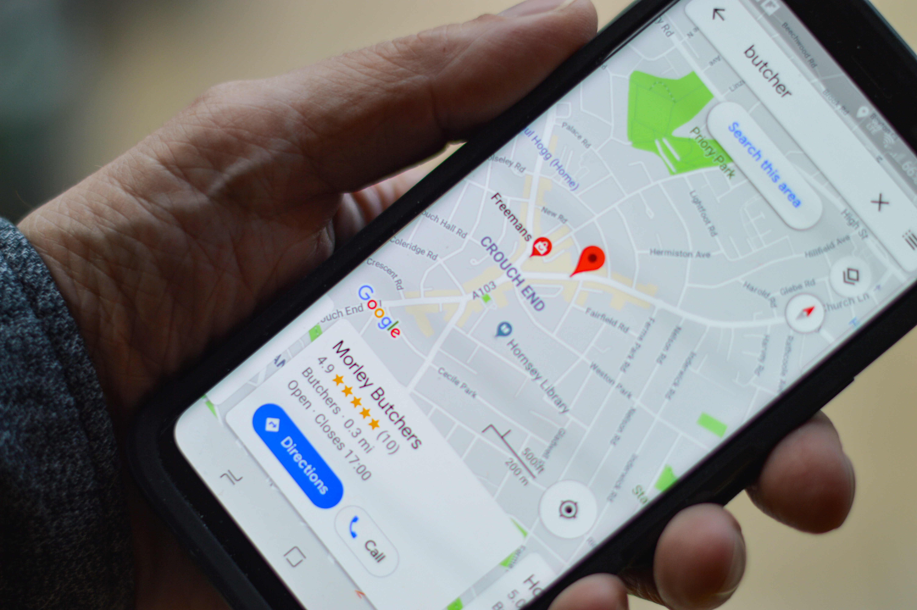
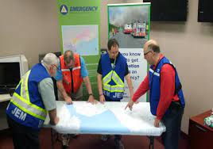

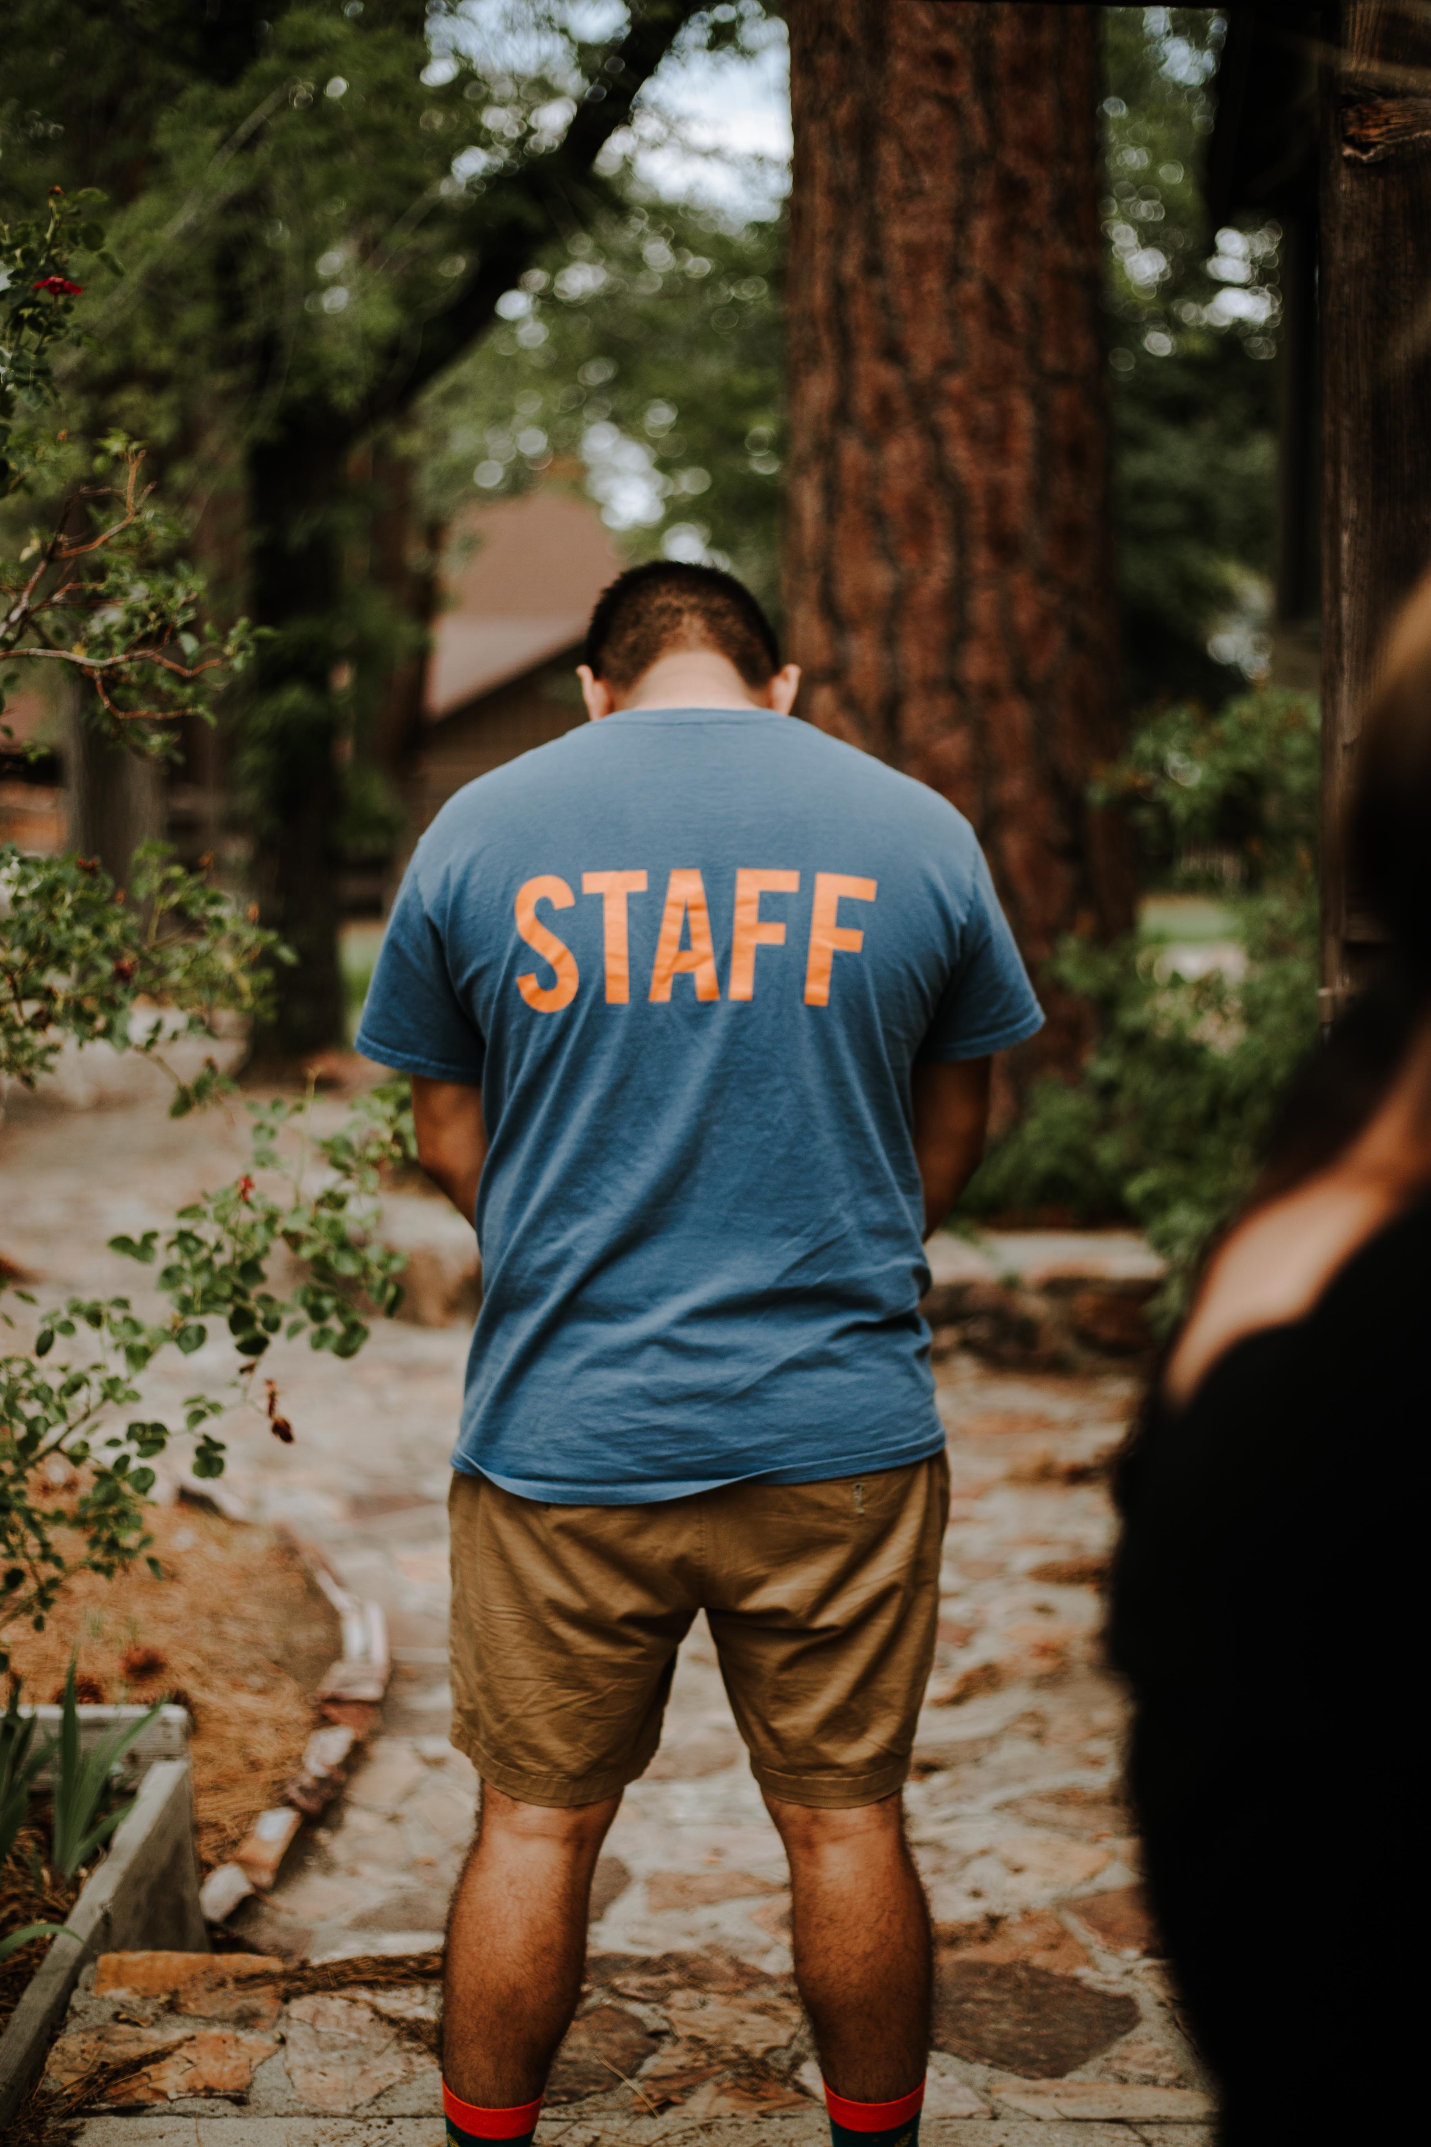
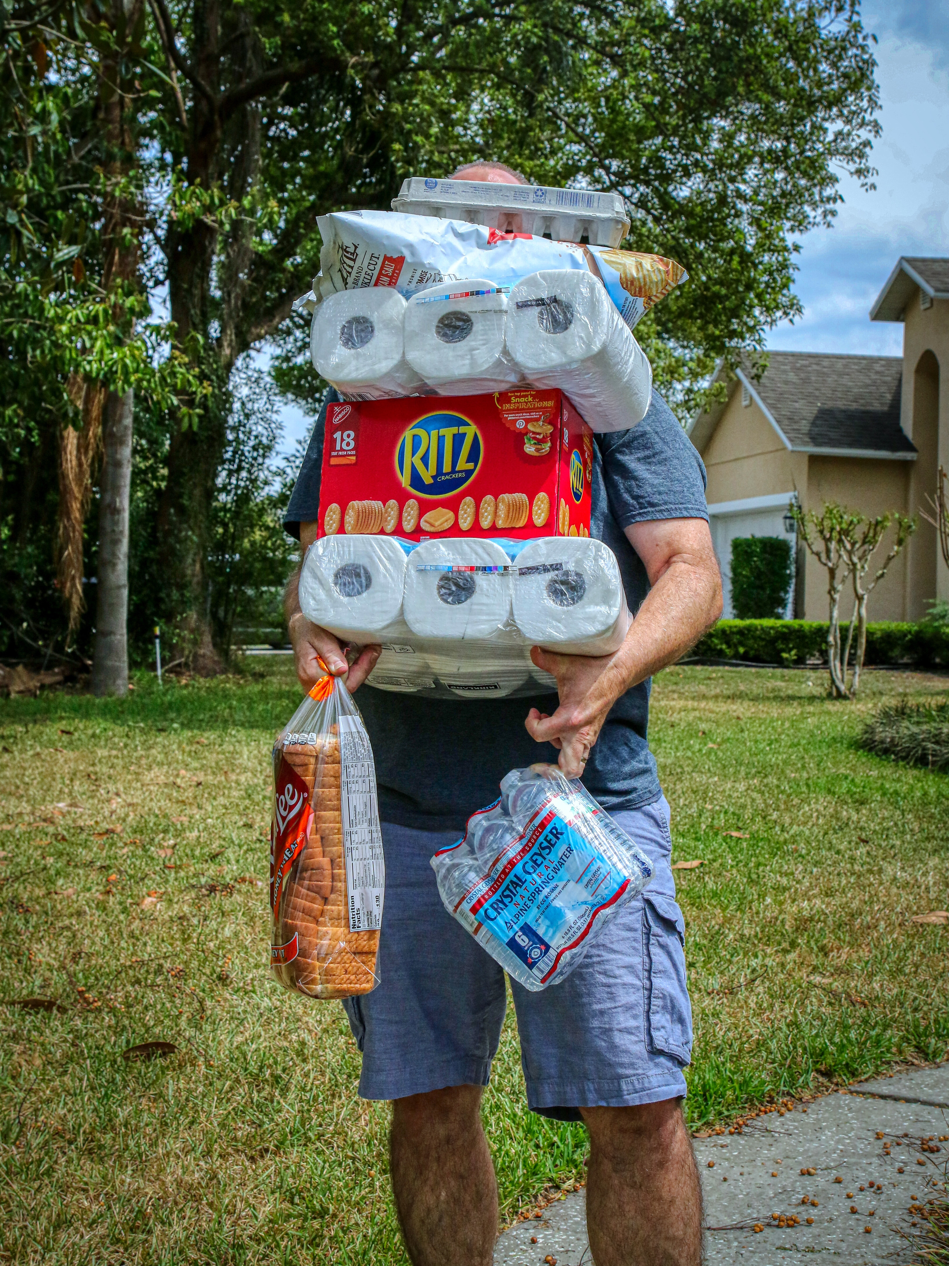
Five elements of a Comfort Centre
Management
Location
Psychosocial
Personnel
Logistics
Notes:
Location
HRM owned facilities when available
Personnel
Trained/aware in Comfort Centre mechanics
Can come from within the community in groups or individuals Photo by Omar Lopez on Unsplash
Management
HRM sponsored Comfort Centres will have HRM trained volunteers in key roles (https://www.facebook.com/hfxfire/posts/have-you-heard-of-joint-emergency-management-jem-teamsjem-teams-are-the-communit/792098081287505/)
CCM level two training for example
Logistics Photo by Mick Haupt on Unsplash
Materials used in the running of the Comfort Centre
Should come from local sources when ever possible
EM will support when local sources are not available
Psychosocial
When identified, Red Cross is notified to provide support for trauma/ Mental health
HRM EM Volunteers are not trained in psychosocial interactions

Slide 14

Comfort Centre Mechanics
Why do we open?
Who approves the opening of a Comfort Centre?
What is an Information Centre?
Notes:
Interactivity:
Of the people that have been involved in a CC, why did you open?
Does EM have stats to show why CC’s have opened?
In other activations of Comfort Centre's other organizations have set up information booths. Is this what an Information Center is?

Slide 15
Why and how does a CC open?
Why open?
JEM, with permission from EMO, opens Comfort Centres after a major event, disruption and/or to support first responders.
Who approves the opening of a Comfort Centre?
Activation of a Comfort Center is done thru the JEM Chair to the EMO Manager or designate
EMO asks that JEM chair opens centre or JEM chair can request through EMO
Notification is done through hfxALERT system
There may be more than one Comfort Centre opened
Depending on need or the size of the event, multiple comfort centres may be opened in the same regions. This could also depend on distance residents may have to travel to a CC
How do the impacted people get information?
Residents register and come back to get information
EMO tries to provide latest planning information to affected residents first before rest of public
Can also be at the request of EMO
Can be at the request of the community through the JEM
Notes:
If cc is open without EM approval, costs are not reimbursed and volunteers are not covered under insurance
Activations are most commonly for: power outage, forest fire, storm surge, hurricanes, extreme heat (cooling center)
Information Center used more for short term events (1-4 hours) i.e. Old Grand Desert target range ordinance disposal

Slide 16
Deactivation
When the need has passed, the Comfort Centre can be deactivated by:
  Comfort Centre Manager sending a message through the JEM Liaison to the EOC (only if staff are not available)
  The EOC informing the Comfort Centre it is no longer required

Slide 17
Supervisory Positions within CC
Comfort Centre Manager (CCM) is the on-site representative of the JEM Chairperson
Over-all command and control of the running of the Comfort Center
Support Staff Supervisor (SSS) oversees the staff that handles the clients
Makes up the schedule for all personnel working the hospitality area
Responsible for all hospitality issues
SSS is answerable to the CCM
CCM and SSS will coordinate Comfort Centre requirements
Food replacement, personnel shortages
Notes:
Spontaneous volunteers may also be called or referred to emergency volunteers

Slide 18

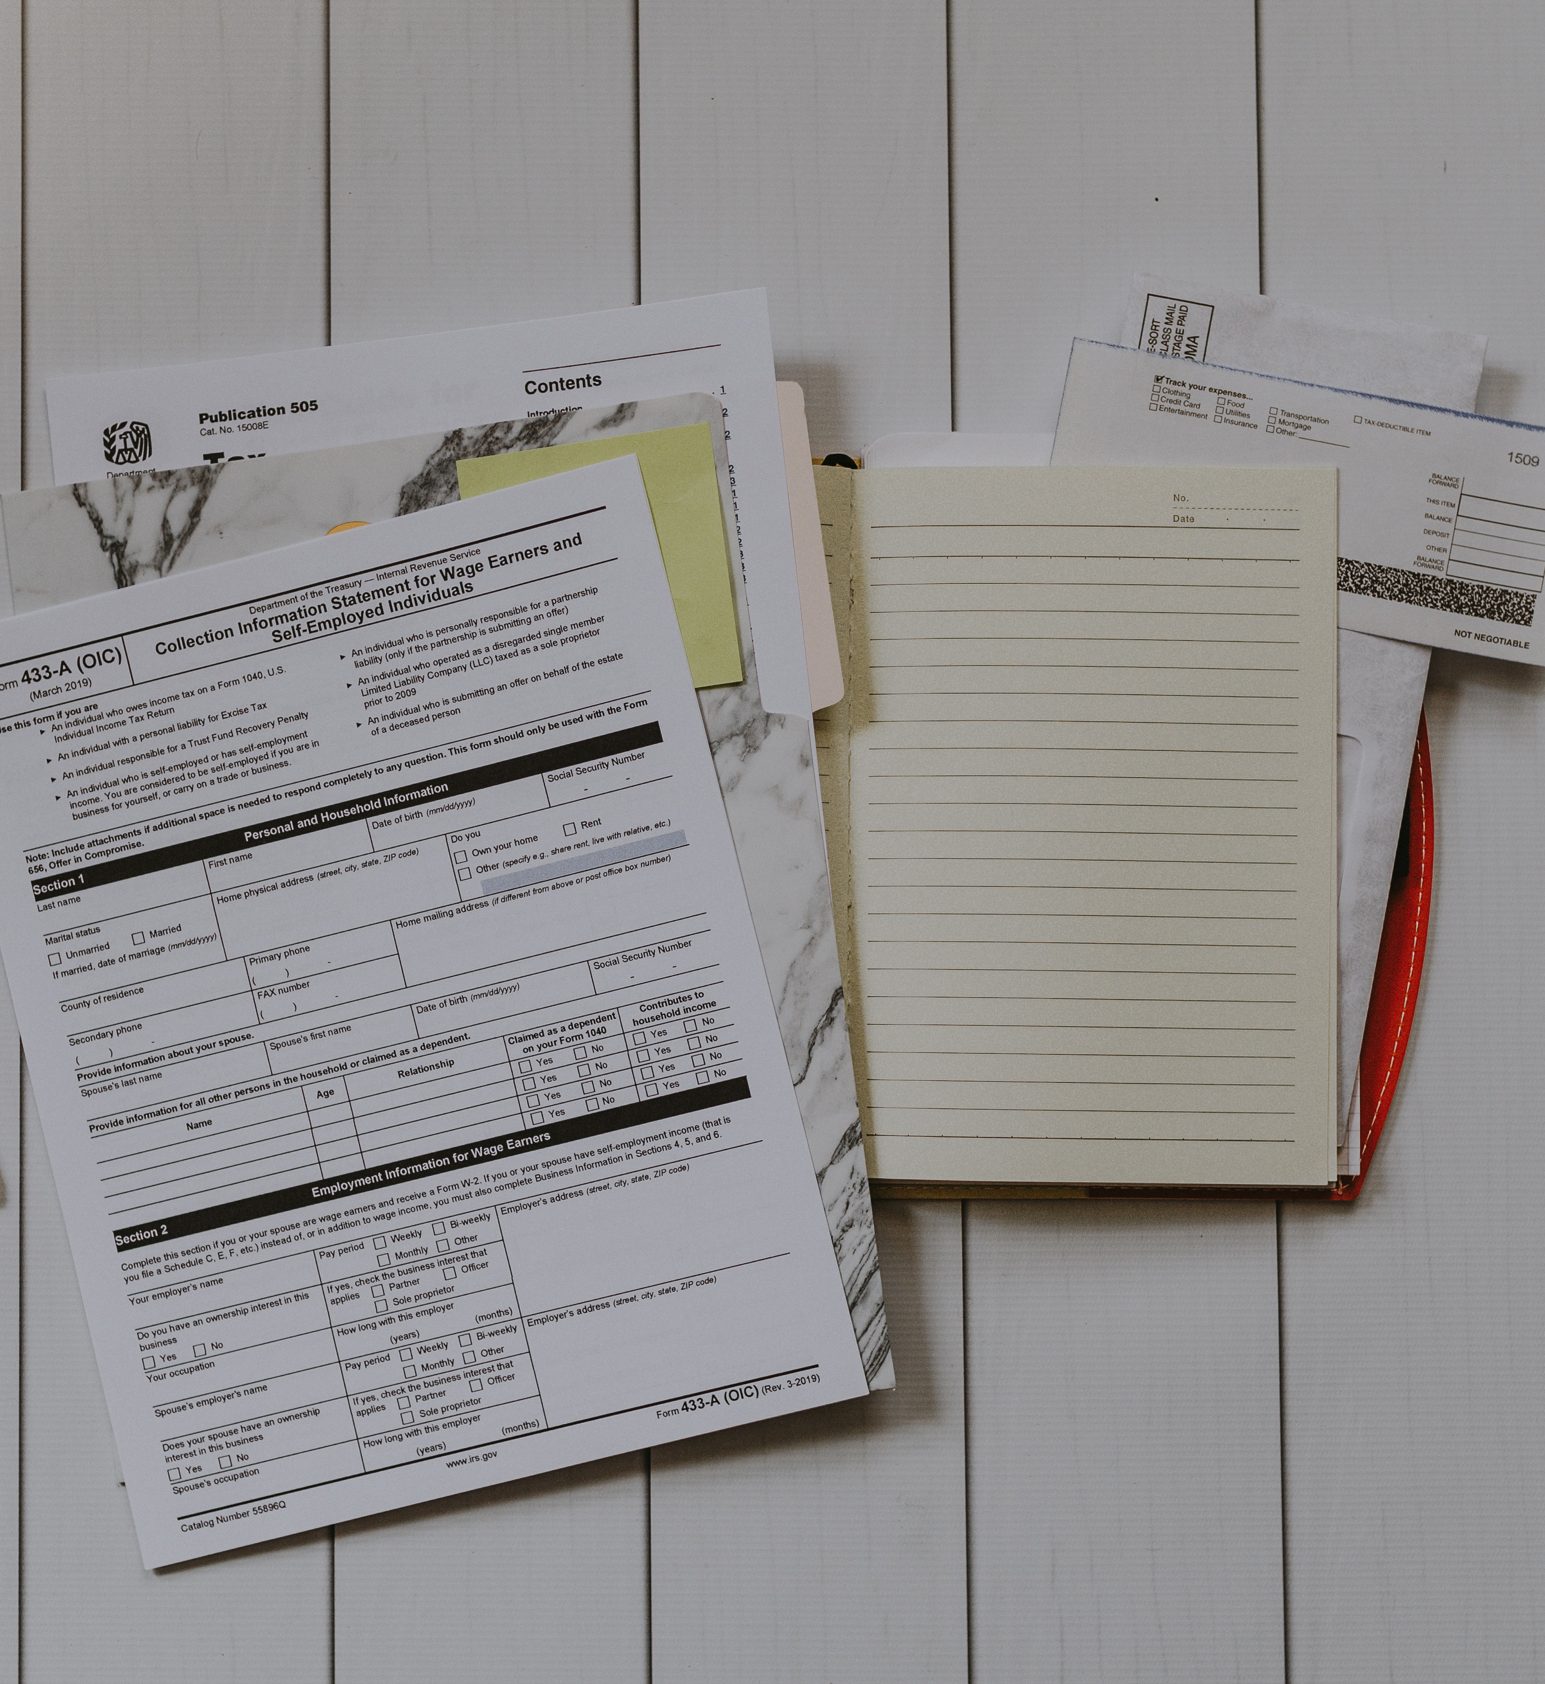

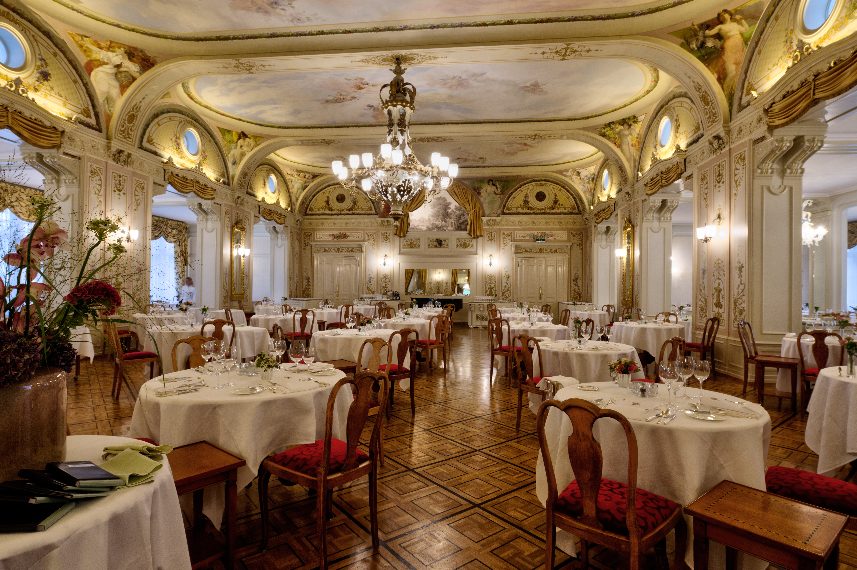
Expectations for Volunteer Staff
Register before working
Stay tidy and neat in appearance
Seating and refreshments
Keep Centre tidy
Reassure displaced residents

Slide 19
Expectations of EM Division staff
Point of contact:
EM is the primary and official HRM staff position that the CCM uses to get information to or from the municipality
Public Information:
All media contacts/requests must be vetted though EMO
EMO will determine HRM’s corporate message and appropriate delivery method
Situation Reports:
EM will expect regular situation reports from the Comfort Centre on a scheduled basis
EM will also provide overall situation reports
This may be coordinated by an EMO Duty Office and/or Comfort Centre Coordinator (larger events with multiple Comfort Centres being opened)
Unresolved Action Items:
EMO expects the Comfort Centre will attempt to resolve local issues whenever possible
Any action items or issues, that require HRM involvement need to be sent to EMO.

Slide 20
Comfort Centre Operations
Registration
Paperwork/forms
Supply line and administration

Slide 21

Opening the Comfort Centre
Document management and control
  Invoices receipts to be forwarded to JEM Chair, to be consolidated to EMO
  Incident logs and forms
Comfort Centres when opening will use the start-up kit, and any other on hand supplies needed.
Logistics support will first be from local suppliers and from within the Comfort Centre stock.
HRM EM will be responsible for support when there is a short fall in the local supply network.
Notes:
On opening after set up the CCM and the Support Staff Supervisor (SSS) will make up a 2 day menu
Invoices should be collected and submitted to the JEM Chair.
JEM Chair will collate these and forward to EM representative for payment/reimbursement.
*Start up kits are a project in progress.
Photo by Katie Moum on Unsplash

Slide 22
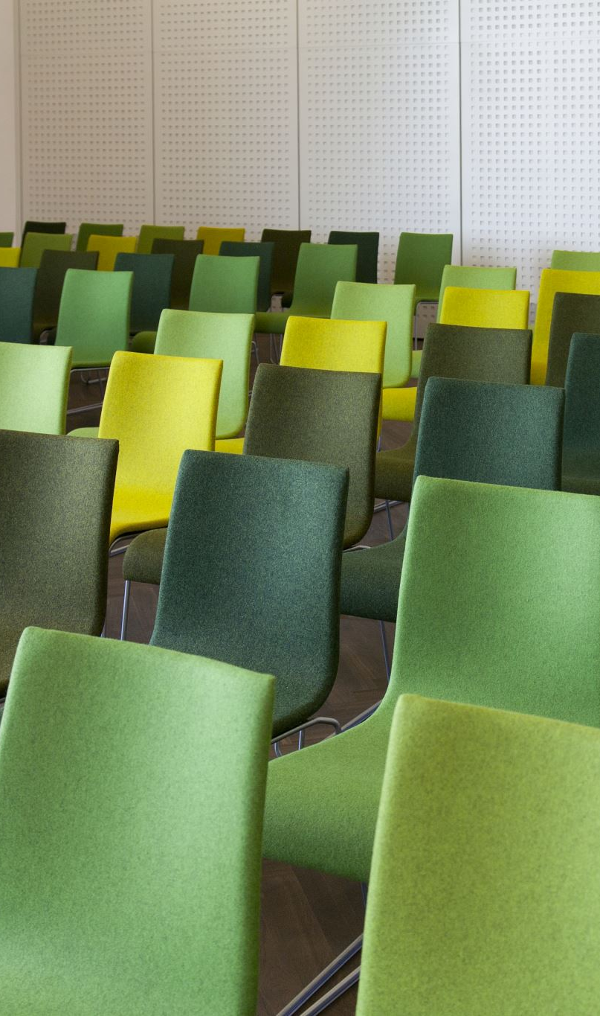
Set up
Tables needed:
  Reception (near front door)
  CCM/Administration
  Eating/ Work areas
Room Set up considerations
  Size and shape
  Numbers expected
  Potential duration of event
  Services being provided
Notes:
*pets may have to accommodate
*children’s area
*seniors
*sensory awareness areas (smaller gathering size, not as loud or active). Autism awareness.
*medical requirements – oxygen tank, Alzheimer's
*

Slide 23

Needs to consider
Seniors, children, mobility issues, medical devices or medical issues
Not all needs are evident
Not all persons with additional needs wish to discuss their needs
Comfort Centre personnel should try to match up needs with existing support in the community
Notes:
Issues that cannot be resolved become action items on the sit-rep
May still be resolved locally at the JEM level
May need to be addressed by EM
There are special needs support groups available
Can be coordinated via
Support agency directly
Persons with Disabilities (provincial)

Slide 24
Situation Reports
(Sit-Reps)
JEM
  Used to establish priorities and action items
  Identify issues
  Sit-rep summary provided to EM on scheduled basis
Sitreps should be conducted on a regular basis to ensure proper needs are met. Sitreps should include # of residents, staff scheduling, any arising issues and supports being provided
Notes:
Internal sit reps
Need to be documented
Numbered
Persons participating listed
Issues discussed
Resolution
Action items
Action items need to be assigned to an individual to resolve
Used to provide a community picture for HRM
External sit-reps
Used for information sharing
Global picture in areas outside of the Comfort Centre area

Slide 25

Discussion Items
What do our volunteers bring to the table?
  Varied backgrounds bring a wealth of expertise
  Ongoing training is good for the organization and the volunteer
Other courses volunteers can participate in:
  Food handling
  Comfort Centre Level 2
  Incident Command 100
  Radio Communications
  Non-Violent Crisis Intervention
Notes:
Ongoing training is good for the organization and the volunteer
Some of the EM sponsored training can be applied in other parts of the volunteer’s life
Skill sets of volunteers (e.g: American Sign Language, languages, etc.)

Slide 26

Questions?

