Slide 1

Comfort Centre Training
Level 2

Slide 2


Introductions
  What organizations are people from?
  Have you been involved in a Comfort Centre opening before?
Notes:
Opportunity for interactivity
Dog - Photo by Charles Deluvio on Unsplash
Open - Photo by Clay Banks on Unsplash

Slide 3
State of Local Emergency(SOLE)
Provincial legislation giving municipalities certain powers
  Confiscate property
  Control travel
  Order evacuations
  Entry without warrant
  Order assistance
  Regulate goods and services
  Price protection
Notes:
https://nslegislature.ca/sites/default/files/legc/statutes/emergency%20management.pdf
NS Emergency Management Act page 10 Para 14 (i)
order the assistance of persons needed to carry out the provisions mentioned in this Section;

Slide 4
Emergency Centre
Which one do I want?
Comfort Centre
Evacuation Centre
Run by Municipality
Managed by EMD
Staffed mostly by local volunteers
Decision to open: HRM
Run by Province
Managed by Red Cross
Staffed mostly by Red Cross volunteers
Decision to open: Department of Community Services
Notes:
Discuss the differences between a Comfort Centre and an Evacuation Centre here
Biggest difference is that a Comfort Centre belongs to HRM, but an Evacuation Centre belongs to DCS
HRM has no staff to run a Comfort Centre and relies on volunteers
HRM sponsored Comfort Centres can only be opened by EMO authorization
Discuss the “HRM Sponsored” here
Insurance
Logistics
Repairs, etc.

Slide 5
Relationship to Humanitarian Agencies
Role of Department of Community Services
Role of the Canadian Red Cross
Other humanitarian agencies
  Salvation Army
10/25 rule and how it applies to HRM
Notes:
Humanitarian response has been the responsibility of the Provincial Department of Community Services (DCS) since Amalgamation
DCS contracts the Red Cross to provide these Emergency Social Services (ESS).
10/25: Ten Families/homes or 25 individuals is the threshold that triggers DCS to become more involved with an emergency

Slide 6
Incident Command System (ICS)
Incident Commander
Safety
Operations
Planning
Logistics
Finance
Information
Liaison
Boss
Support Staff
Doers
Thinkers
Getters
Payers
Notes:
Incident Command System (ICS) is becoming a North American standard in Emergency Management
Has been adopted in Nova Scotia and HRM for all first response agencies (Fire, Police and Medical)
Humanitarian agencies are also adopting ICS
Is based on expandability as the situation requires
Five main areas:
Command: leadership
Operations: actions
Planning: ensuring actions are done in a controlled manner
Logistics: materials needed to support actions
Finance: ensuring event is fiscally responsible
Safety: for the entire site, all agencies
Information: ensuring the pubic receives timely, accurate information
Liaison: all responding agencies are coordinated

Slide 7
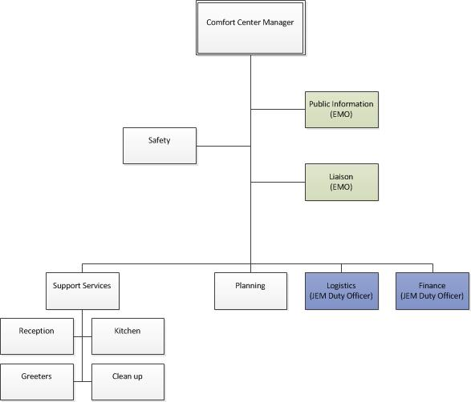
Typical Comfort Centre Under ICS

Slide 8
How Comfort Centres Fit Into The Bigger Picture

Slide 9
Five Elements of a Comfort Centre
Location
Personnel
Management
Logistics
Psychosocial
Notes:
Location
HRM owned facilities when available will be used 1st
Personnel
Trained/aware in Comfort Centre mechanics
Can come from within the community in groups or individuals
Must fill out a HRM Volunteer Application
Management
HRM sponsored Comfort Centres will have HRM trained volunteers in key roles
CCM level one/two training
Food handling
Logistics
Materials used in the running of the Comfort Centre
Should come from local sources when ever possible
EMD will support when local sources are not available
Psychosocial
When identified, Red Cross is notified to investigate and action
HRM EMD Volunteers are not trained in psychosocial interactions

Slide 10
Comfort Centre Mechanics
What are “Emergency Centres”
  Information Centres
  Comfort Centres
  Warming Centres
  Reception Centres
  Evacuation Centres
Transition from a Comfort Centre
Notes:
FIVE types of Emergency Centres:
Information Centre
Organization, independent or dependent of an institution, whose task is to collect, manage and make available to users information related to a given area. (Termium) A location where members of the affected public can congregate and where major announcements are made, before notifications to media have occurred. (MEP)
Comfort and Information Centres
Can be opened at Municipal discretion
Warming/Colling Centre
Used in extreme temperatures to allow public to get warm or cooled off
Typically will be HRM libraries and run by trained staff
Reception and Evacuation Centres
Can only be opened by Province
Contracted o the Red Cross by the Provincial Department of Community Services.
A Comfort Centre can transition to a Provincial Evacuation Centres.
Transfer of command from the Municipality to the Province occurs
Management will change
Staff may or may not change
What is the difference between Info and Comfort Centre??

Slide 11
Comfort Centre Mechanics
Who determines the location of the Comfort Centre?
  HRM EMD along with
  Prior and on-going consultation with local JEM team & community groups
  and
  Based on work of the JEM & community
  Based on Sector Profiles
Notes:
Based on need
Numbers that may be expected to attend
Size of facility needed
Time the Centre can be expected to operate vs future needs of facility
Location to the affected area
Accessibility
Sector profiles
Small, usually community based areas within HRM
Preparedness work already done in the community
Potential Comfort Centres identified and contacts made
Evacuation routes
Local infrastructure noted: schools, churches, special care facilities, dams, roadways, rivers, etc.
Hazards identified: gas/propane stations, dry cleaners, chemical storage facilities, etc.

Slide 12
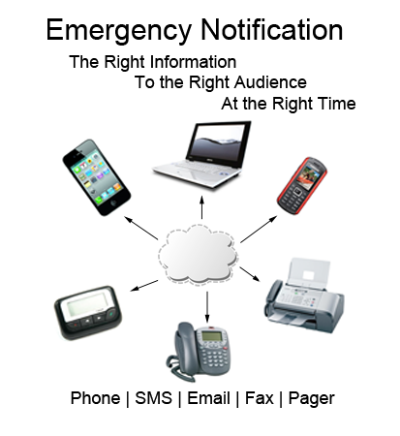


Activation/Deactivation
Request is by or made to EMD
  (i.e.: request can flow up-line or down-line)
EMD recommends to CAO
CAO authorizes
hfxAlert
  Owned & Operated By HRM
Alert Ready
  Operated By NS EMO
Notes:
https://www.halifax.ca/fire-police/fire/emergency-management/hfxalert
Activation of a Comfort Centre is done thru the JEM Chair or Duty Officer (DO) to the JEM EOC Liaison Officer (LO) and or EMD Manager.
There may be more than one Comfort Centre opened
Depending on need
Availability of the five elements
EMD/JEM EOC LO will normally work with the JEM Duty Officer not the Comfort Centre Manager
Deactivation, when the need is passed:
accomplished by a message from the Comfort Centre Manager
to JEM Team’s DO
to JEM EOC LO
to EOC
hfxAlert is a computerized telephone mass notification calling system
Sends pre-recorded messages
Pre-determined persons on established lists
72 phone line are available to make simultaneous calls
E-mail, voice, text can be sent
Report generated showing how many calls received and which ones not received

Slide 13
Positions/Roles
Comfort Centre Manager (CCM)
  Overall in-charge
  Management of Comfort Centre
Support Staff Supervisor (SSS)
  Responsible for hospitality issues
  Develops hospitality work schedule
  Reports to CCM
Notes:
Comfort Centre Manager (CCM) is the onsite representative of the JEM Chair and or Team’s Duty Officer person
Over-all in charge of the running of the Comfort Centre
Support Staff Supervisor (SSS) is in charge of the staff that handles the clients
Makes up the schedule for all personnel working the hospitality area
Responsible for all hospitality issues
SSS is answerable to the CCM
CCM and SSS will coordinate Comfort Centre requirements (Food replacement, personnel shortages)
CCM and SSS may have assistants to assist them in their role
The Assistants will be directly under the CCM or the SSS
They will be persons who are a registered member of JEM
Emergent volunteers
May be used
Must fill out a volunteer application 2023 form
Not in managerial roles due to liability issues

Slide 14
Set Up
Tables/Chairs needed:
  Reception (near front door)
  CCM/Administration
  Patrons
Room Set up considerations
  Size and shape
  Numbers expected
  Potential duration of event
  Services being provided
  Public Health Measures
  Special Needs
Notes:
Public health measures i.e. COVID 19

Slide 15
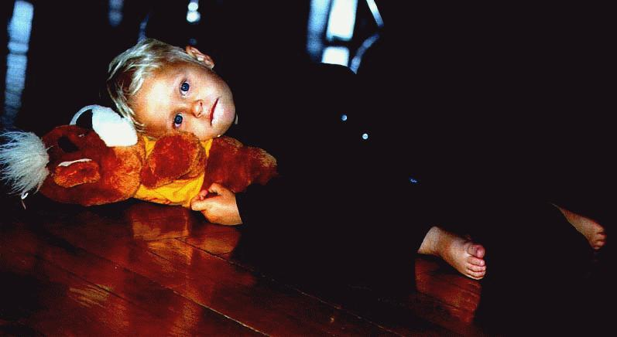
Expectations of Staff
Register before working
Be tidy and neat in appearance and wear ID.
Provide seating and refreshments for clients
Keep centre tidy and safe
Notes:
Expectations of the staff
All personnel will register before entering the Centre to work
Allows us to ensure person has insurance coverage
Crucial should the Centre experience an Emergency Evacuation
Personnel working in a JEM Comfort Centre will be tidy and clean appearance and wear ID.
Representing themselves, their community, the JEM, EMD and HRM
Will assist clients with seating and refreshments
Some persons coming in may be confused or upset and not thinking clearly
It is everyone's responsibility to keep the centre clean

Slide 16
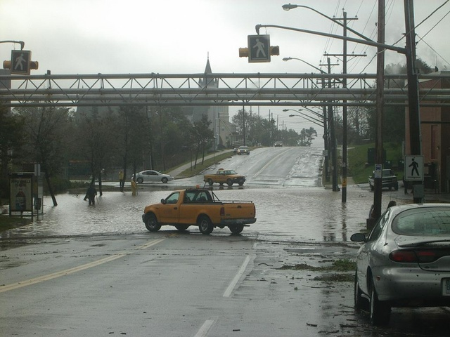
Expectations of EMD
Point of contact for CC Manager through the JEM
Public Information
Situation Reports
Unresolved action items
Notes:
Point of contact:
EMD is the primary and official HRM staff position that the CCM uses to get information to or from the municipality
Public Information:
All media contacts/requests must be vetted though EMD
EMD will determine HRM’s corporate message and appropriate delivery method
Situation Reports:
EMD will expect regular situation reports from the CC on a scheduled basis
EMD will also provide overall situation reports, also on a scheduled basis.
This may be coordinated by an EMD EOC JEM LO and/or CC Coordinator (larger events with multiple comfort centres being opened)
Unresolved Action Items:
EMD expects the CC will attempt to resolve local issues whenever possible
realizing that it cannot commit any resources to an issue.
Any action items or issues, that require HRM involvement need to be sent to EMD via the JEM team.

Slide 17
Expectations of Elected Officials
Are welcome/encouraged to visit a CC
Report to the CC Manager upon arrival
Do not override CC Manager’s authority
Will offer assistance when able
Notes:
Welcome/encouraged to visit:
Local Councillor has tremendous knowledge of local area and local concerns
Can be a great source of information to the CCM and residents
Report to CCM:
Elected officials are instructed to report in with the CCM when arriving
as a courtesy
so that the CCM is aware that they are on site
Do not override CCM’s authority:
The CCM works for EMD and is part of an EMD operation.
The Comfort Centre is part of the overall operation of the event
The elected official is not considered operational in an emergency
Offer assistance:
The Councillor should be encouraged to offer whatever they can do help
It must flow through the CCM to ensure that whatever they are doing compliments the overall operation of the comfort centre.

Slide 18
Registration
Staff
  All personnel to register on arrival
  All personnel to check out before leaving
Clients
  All clients to register on arrival
  All clients to check out before leaving
Notes:
All personnel will register before entering a Comfort Centre
If the registration point is not functioning at the time of entrance then the SSS will make note of their personnel and turn it over to the CCM
ALL Personnel will check out at the time of leaving the Comfort Centre
All clients will register or will not be allowed into the Comfort Centre
A client will check out when leaving the Comfort Centre
Service animals cannot be turned away
The public must register or not allowed in
Safety
Accountability
Insurance
Animals/Pets
Proof of ownership
Must bring pet supplies: food, dish, medications, cage, etc.
No agricultural animals: horses, ponies, chickens, pigs, etc.
No animals for profit: breeders, show animals, etc.

Slide 19

Paperwork and Forms
Notes:
Need:
Incident Log
Volunteer Timesheet
Volunteer Schedule
Comfort Centre Resident Tracking Sheet
Menu Planner
Requisition Form
Comfort Centre Report

Slide 20
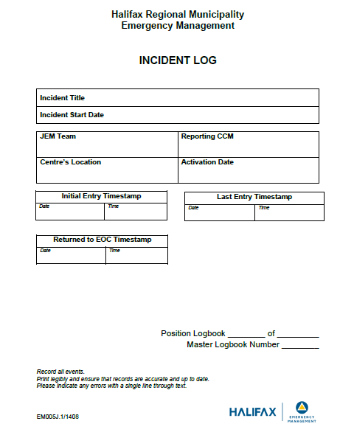

Slide 21
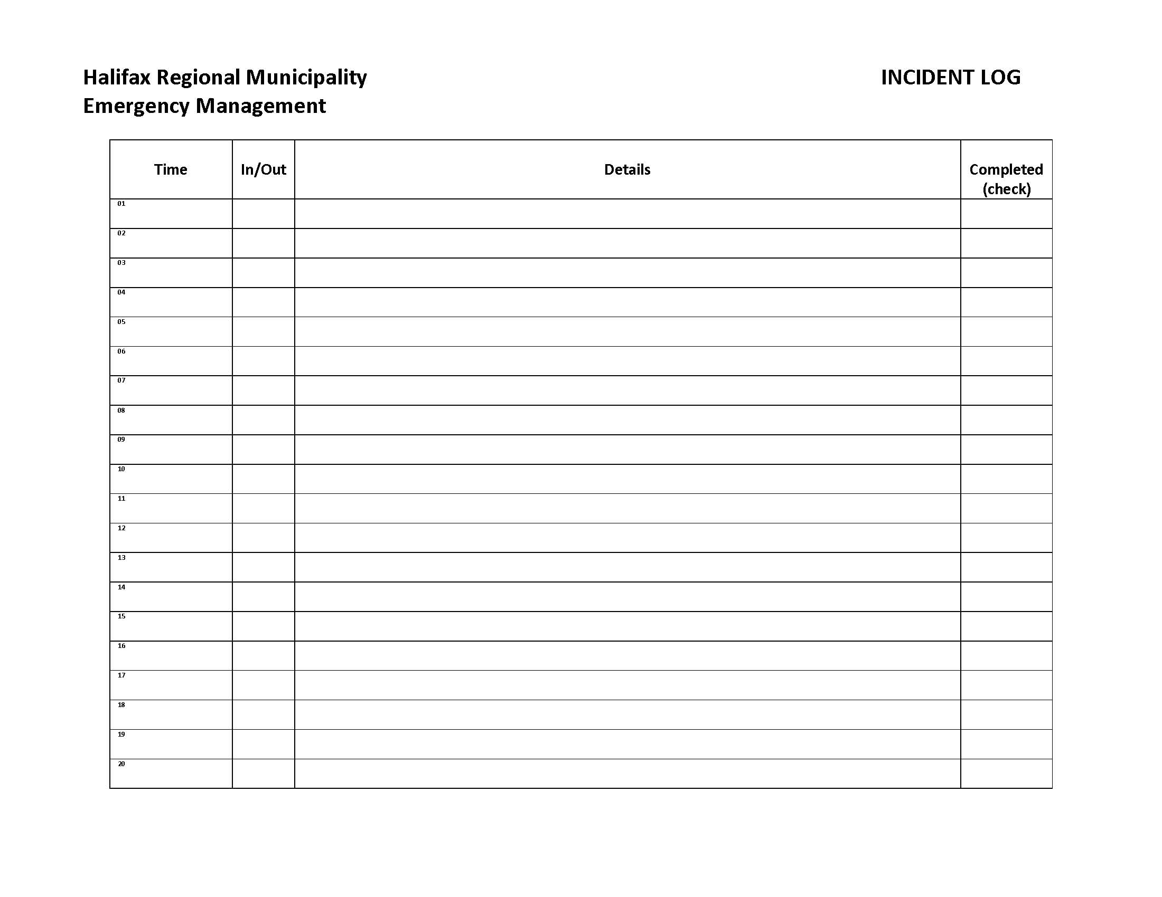

Slide 22
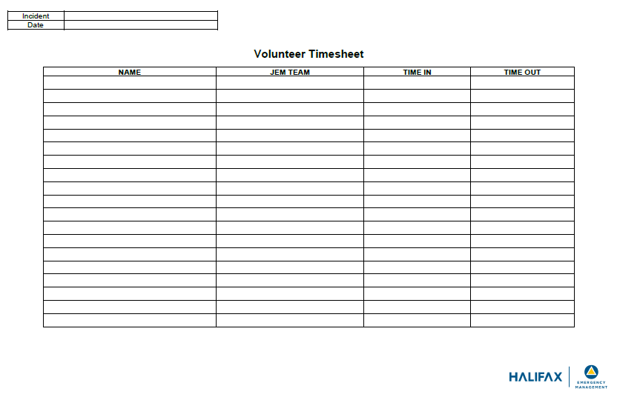

Slide 23
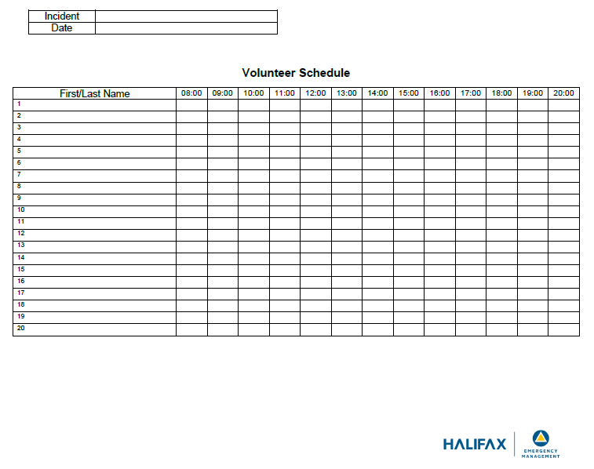

Slide 24
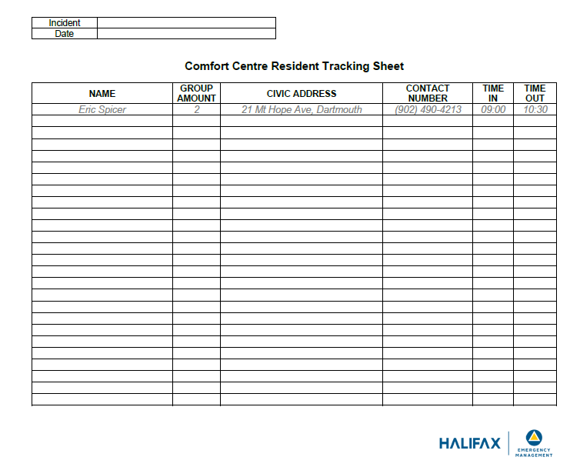

Slide 25
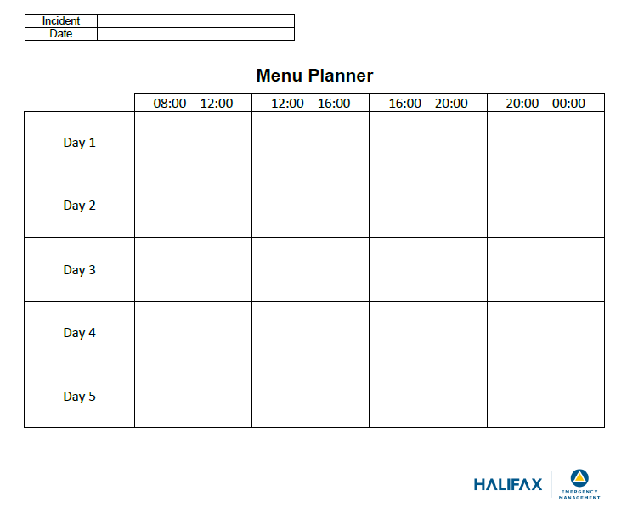

Slide 26
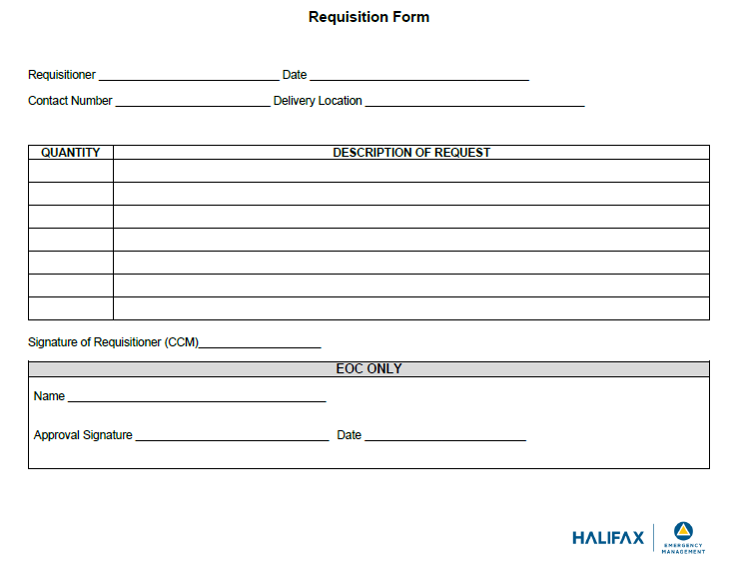

Slide 27
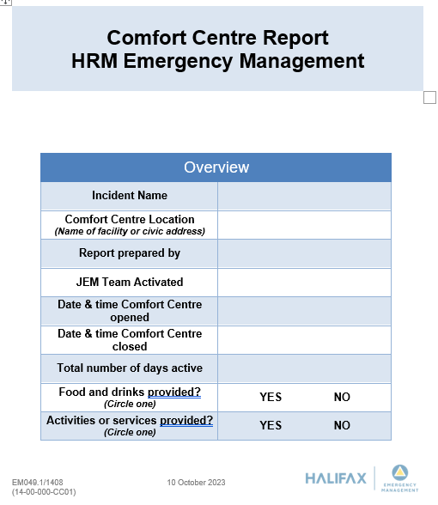

Slide 28
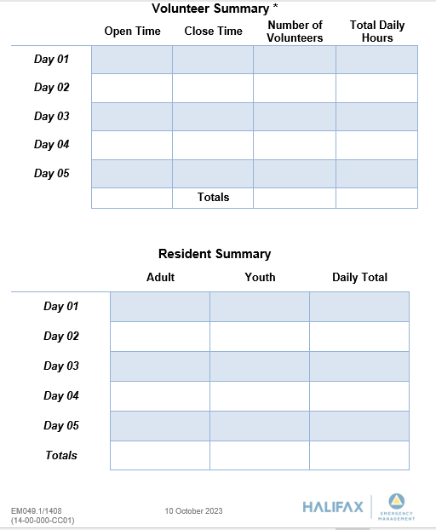

Slide 29
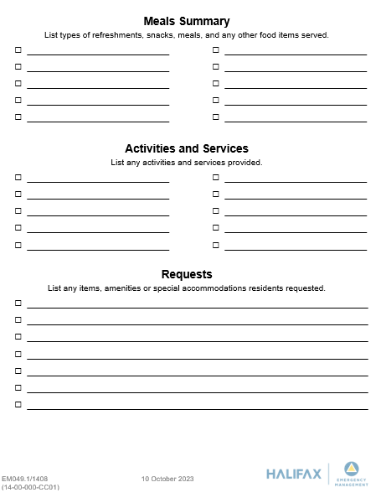

Slide 30
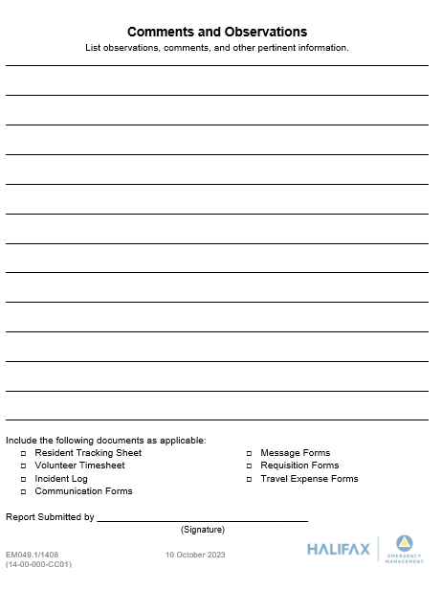

Slide 31
Supply Line and Administration
Comfort Centre Logistics
Comfort Centre Administration

Slide 32
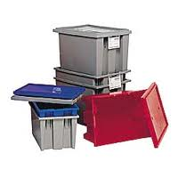

Comfort Centre Logistics
Opening:
  Start up kits
Ongoing:
  Logistics support from local suppliers
  From within the Comfort Centre supplies
  HRM EMD
Notes:
Comfort Centres when opening will use the start up kit plus another on hand supplies needed.
Logistics support will first be from local suppliers and from within the Comfort Centre stores.
HRM EMD will be responsible for support when there is a short fall in the local supply network.

Slide 33

Comfort Centre Logistics
HRM EMD can deliver if needed
Coordinated through the JEM Duty Officer
Notes:
HRM EMD will arrange delivery of supplies when the JEM Team exhausts it’s own network
JEM Duty Officer will delegate who, where and whom will deliver the start up kit.

Slide 34

Comfort Centre Administration
Everyone to be accounted for
  Clients
  Staff
On-going menu for 48 hours
Document management and control
  Invoices receipts to be forwarded to JEM Chair
  Incident logs and forms
Notes:
Comfort Centre Manager (CCM) is responsible for ensuring everyone at the Comfort Centre is properly recorded
On opening after set up the CCM and the Support Staff Supervisor (SSS) will make up a 2 day menu
CCM will pass this menu plus invoice to the JEM Duty Officer (JEMDO) for action

Slide 35
Miscellaneous
Disabilities and senior awareness
Situation reports (internal)
Information flow
Telecommunications
State of Local Emergency (SOLE)

Slide 36
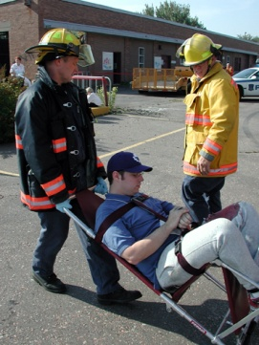
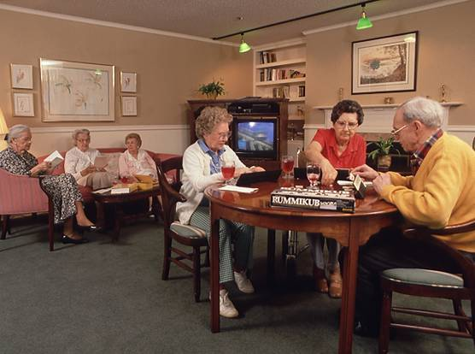
Disabilities and Senior Awareness
Identification of special needs at the centre
Assessment of needs within community
Action items determined
  Sourced locally
  Sourced externally
Notes:
Persons with special needs may need additional support
Not all special needs are evident
Not all persons with special needs wish to discuss their needs
CC personnel should try to match up needs with existing support in the community
Issues that cannot be resolved become action items on the sit-rep
May still be resolved locally at the JEM level
May need to be addressed by EMD
There are special needs support groups available
Can be coordinated via
Support agency directly
Persons with Disabilities (Provincial)

Slide 37
Situation Reports
(Sit-Reps)
Internal
  Used to establish priorities and action items
  Identify issues
  Sit-rep summary provided to EMD on scheduled basis
External
  Provided by EMD
  HRM overview
  Local to area as well
Notes:
Internal sit reps
Need to be documented
Numbered
Persons participating listed
Issues discussed
Resolution
Action items
Action items need to be assigned to an individual to resolve
Used to provide a community picture for HRM
Typically scheduled one hour before HRM EOC Planning cycle meeting
External sit-reps
Used for information sharing
Global picture in areas outside of the Comfort Centre area
Come from HRM EOC or on site representative, I.e. Erica Fleck or staff

Slide 38
Information Flow
From clients
  To staff, then to EMD for action as needed
  From EMD to EOC as needed
From EMD
  Collected in Operations Centre(s)
  Collected from other Comfort Centres, JEM teams
  Collected from other agencies
  To CCM for distribution as needed
Notes:
Important: the local JEM needs to be the conduit for all information from EMD and to EMD.
Especially true when there are multiple Comfort Centres established
All information is considered personal until directed otherwise
Personal information cannot be shared publicly

Slide 39
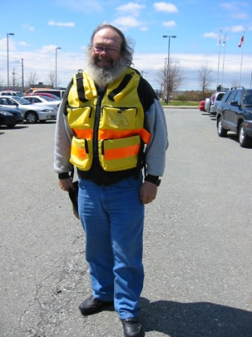
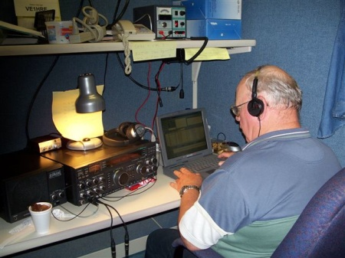
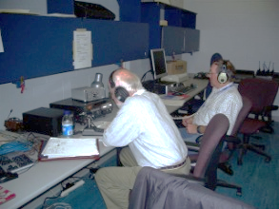
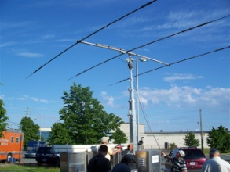
Telecommunications
Existing facility telephones
Mobile phones as available
Two way radios (EMD provided)
Amateur Radio
Notes:
Telecommunications are part of the EMD/JEM structure
Each JEM Team in HRM has a facility to set up telecommunications
Called a JEM Support Center (JSC)
JEM Team Duty Officer has a TMR2 Handheld radio
Telecommunication services may be provided to a Comfort Centre upon request
EMD has access to several types of radios
TMR
VHF
UHF
Amateur Radio
The VHF/UHF radios are completely independent of all other systems and are mobile, complete with a mobile repeater on a trailer
the trailer usually goes to all the JEM Jamborees
Halifax Auxiliary Telecommunications Service)(HATS)- Amateur Radio operators can deploy to Comfort Centres

Slide 40
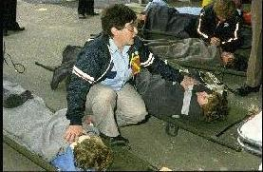
Training
Skill sets of volunteers (e.g.: ASL, languages, etc.)
Other courses
  Comfort Centre Level 1 & 2
  Food Handling
  Meet & Greet
  Duty Officer Training
  Basic Emergency Management (BEM)
  Incident Command System ICS100
  Radio Communications
Notes:
What do our volunteers bring to the table?
Varied backgrounds bring a wealth of expertise
Ongoing training is good for the organization and the volunteer
Some of the EMO sponsored training can be applied in other parts of the volunteer’s life

Slide 41
Common Concerns/What To Do
Medical Issues
  Call 911
  Assist to your level of training
  Ask if others have medical training
Security
  Call 911
    Request police
  Advise EOC
  Try to remove children and others from area
  Do not intervene

Slide 42
Donations
HRM EM policy: CCs do NOT accept donations
  Food, Clothing, Toys, Materials, etc.
EM will advise as to where best to direct individuals, companies, etc. wishing to donate
EM has no way to manage donations and becomes a huge problem during and after event

Slide 43
PRACTICAL

Slide 44
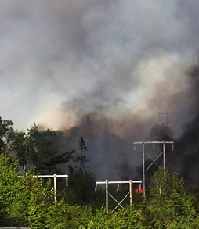
Forest Fire Discussion Exercise
Notes:
This can be conducted in several ways:
Group discussion as a whole
Individual groups discuss and present
Notes:
This exercise is to demonstrate ability to manage a Comfort Centre.
Photo: https://novascotia.ca/natr/forestprotection/wildfire/media-guide/

Slide 45
Purpose
This exercise is to demonstrate ability to manage a Comfort Centre.

Slide 46
EM Requesting Opening Comfort Centre in HRM Facility
Forest Fire
200 homes with 450 citizens evacuated
Anticipated Centre to be open for 2 days
Today is a Friday 7:00
Mid July
Weather 30C, light winds, Humidity 80% and no rain in forecast for next 5 days
No power outages
Good evacuation routes
EM wants CC open at 10:00
EM has identified a HRM Owned Recreation Centre in your JEM area for the CC

Slide 47
Things To Think About
Prior to opening
Setup
Running
Communications
Reports
Documentation
Closing

Slide 48
What Steps do You Need to Take
You get the call at 7am
Must open by 10am
1st CCM SitRep 11:30am
1st EOC SitRep 12:30
2nd CCM SitRep 15:30
2nd EOC SitRep 16:30
3rd CCM SitRep 18:30
3rd EOC SitRep 19:30

Slide 49
Exercise Updates
10 am you have:
Families (6)
  2 with an infant
  2 with 2 toddlers each
  1 with 2 teenagers
  One couple
  Unknown medical issues
Seniors (8)
  2 men and 2 women in late 70’s early 80’s
  One man on oxygen
  One female in wheelchair with care giver
  One man using motorized scooter
  Unknown medical issues
Teenagers (10)
  13-16 years old
  6 females
  4 males

Slide 50
1st EOC SitRep 12:30
Fire is continuing to grow in size
No homes threatened at this time
2 DNR helios working fire
DNR and HRFE fire crews working to surround and contain fire

Slide 51
Injects
12:15 Arrival of elderly couple with 4 dogs and 2 cats
15:00 90 year old male takes heart attack

Slide 52
2nd EOC SitRep 16:30
Fire continues to grow
Blackmore subdivision homes maybe at risk
Halifax Fire setup protective measures

Slide 53
3rd EOC SitRep 19:30
Fire has jumped the highway and has increased in size
More fire resources on the way
Projecting Residents will not be allowed back until late pm tomorrow.
Fire crews will be coming out of woods at 21:30 and will monitor fire growth over night
Close CC at 23:00 and reopen 7am tomorrow

Slide 54
1st EOC SitRep 07:00 (Day2)
Fire as died down over night
Fire is 90% under control
Still some areas where residential structures at risk
Smoke still health risk to area evacuated
DNR projecting to have fully under control by noon
Next SitRep scheduled for 12:00

Slide 55
2nd EOC SitRep 12:00 (Day2)
Forest Fire under Control no longer a treat to residences
Shut down Comfort Centre 15:00
15:00 Residents will be allowed back in homes
Public announcement on TV, Radio and social media
Final CCM SitRep 14:30

